Slide 1

Team Auto-Crash
Chicago Car Crash Analysis
2023 Feb
Northwestern University
Paul Brown, Jess Greco, Michael O’Leary, Connor Thomas

Slide 2
01
City of Chicago Vehicle Crash Data
Data gathering and analysis process

Slide 3
What contributes to vehicle collisions in Chicago?
Initial questions we set out to answer:
What variables have an effect on the severity of crashes?
What make/model is involved in the most collisions?
How can we visualize vehicle crashes in Chicago?

Slide 4
Data Gathering
Chicago Data Portal
Chicago Police Department data on all vehicle incidents from 2015- present. Made up of entries from reporting officers.
Datasets used:
Traffic Crashes - Vehicles
Traffic Crashes - Crashes
Traffic Crashes - People

Slide 5
02
Data Exploration
Data exploration and cleanup process

Slide 6
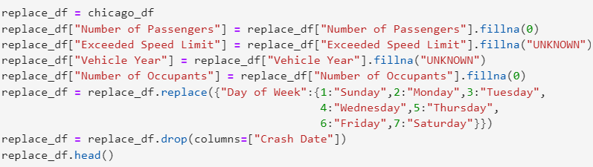
Data Cleaning Process
INITIAL EXPLORATION:
CSV imports, deletion/splitting columns, column renaming
Vehicle and crash dataframe merge
Fill NaN columns with 0
Narrow [“Vehicle Type”] to cars only
Fi

Slide 7
03
Key Findings
Summary statistics and analysis process

Slide 8
Visualizing Chicago Crash Data
Injury Type
Fatal Injuries (2018-2022)
Fatal Injuries (2022 only)
Non-incapacitating injuries (2022)
Make
Plotting accident locations involving the car involved in the most fatal collisions (2018-2022)
Location
Top three crash locations in the city (2018-2022, all injury types)
Notes:
I created maps using HvPlot to visualize crashes by injury type, severity, and location throughout the city. I started by narrowing my search to the last five years for the sake of efficiency and visualization purposes. Then I created maps for crashes involving fatal injuries from 2018-2020, fatal injuries for the last year only, and non-incapacitating injuries form the last year only. I also plotted the locations of crashes involving the make of car which occurs the most frequently in the dataset, as well as a map of the three locations with the highest amount of crashes. For the sake of time, I will only be going over data from 2022 and location data.

Slide 9
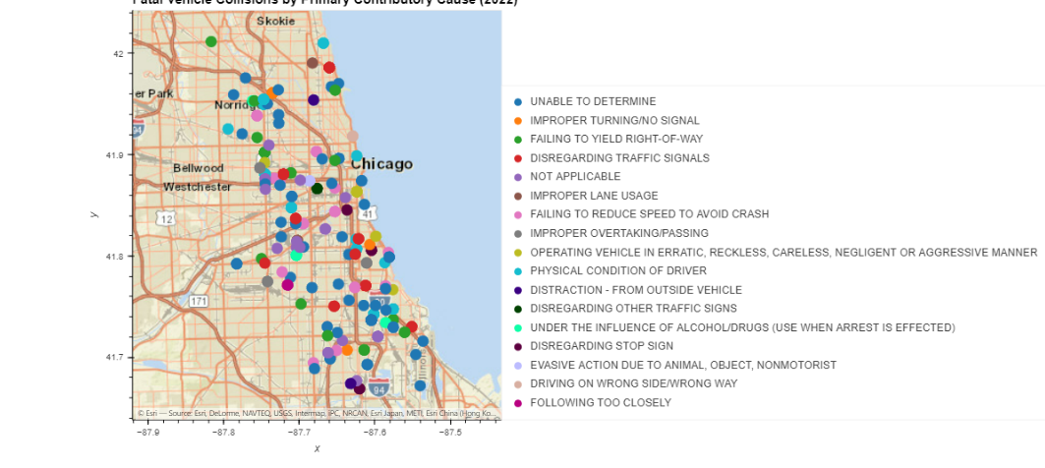
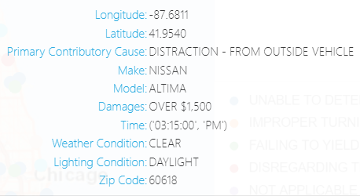
2022 Crash Data:
Where “Injury Type” =“Fatal”
Notes:
We’ll start with the crash data from last year, 2022. In total, there were 961 crashes that resulted in a fatality. I plotted the points by Primary Contributory Cause, and included hover columns for further insight.

Slide 10
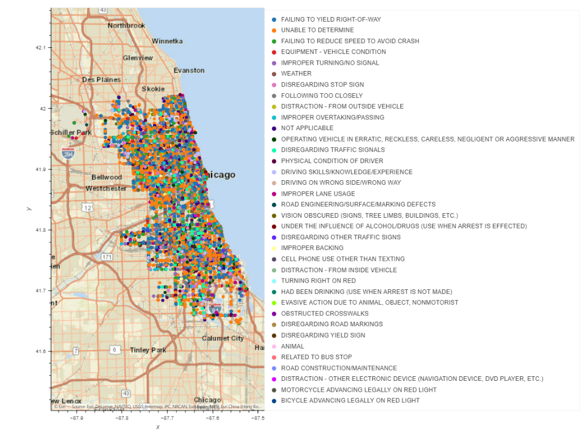
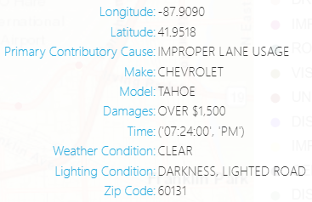
2022 Crash Data
Where “Injury Type” =“Nonincapacitating”
Notes:
There is a very noticeable difference when we look at non-fatal crashes, specifically where the injury type is recorded as non-incapacitating. In total, there were 15,621 collisions that resulted in non-incapacitating injuries. I originally wanted to include the other injury types as well, but even with multiple filters, there were too many data points to make sense of or load.

Slide 11
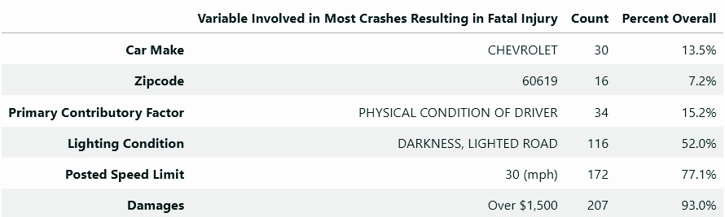
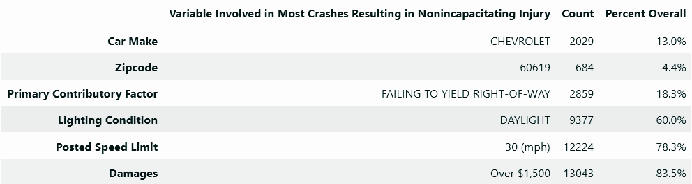
Injury Type: Fatal vs Non-incapacitating
Fatal Injuries
Non-
incapacitating Injuries
Notes:
Preliminary analysis of these numbers suggests a correlation between lighting condition, posted speed limit, damages and the severity and frequency of car crashes with respect to each variable; however, we cannot definitively state the nature or significance, if any, of these relationships without further analysis and statistical testing, some of which will be covered later on.

Slide 12
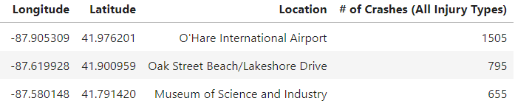
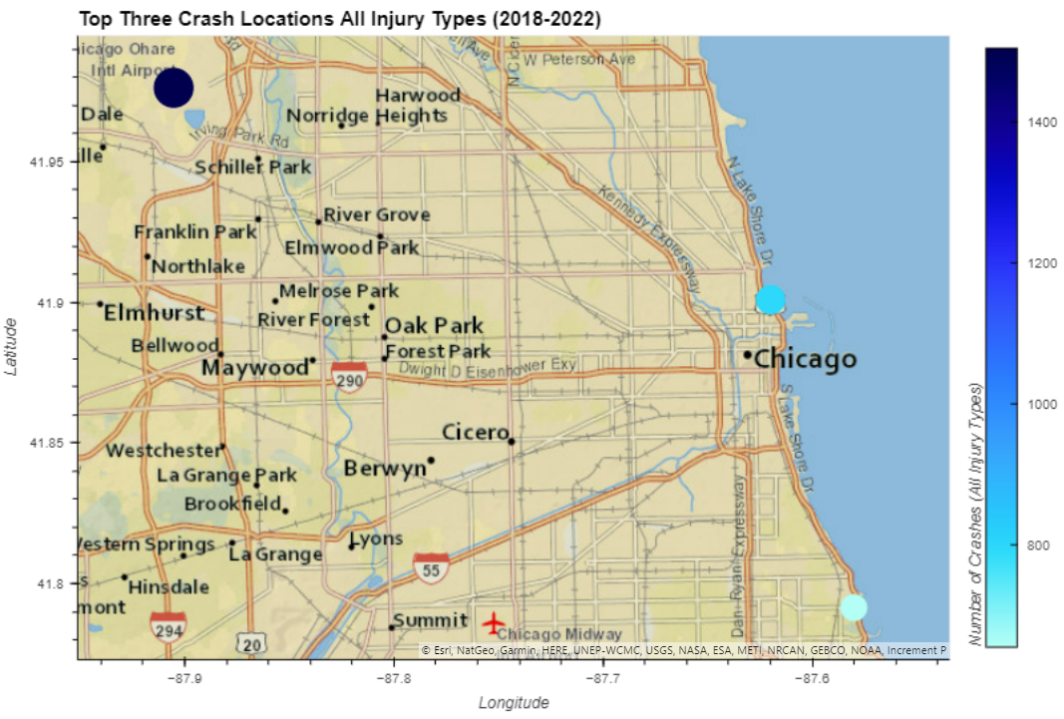

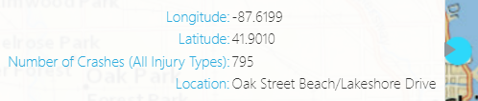
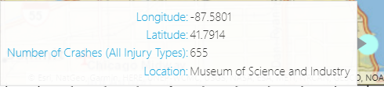
Top 3 Crash Locations
All injury types (2018-2022)
Notes:
Finally, the three locations that appear most frequently in the data were calculated to determine where the majority of accidents (all injury types) occurred from 2018-2022. Using Google Maps and longitude/latitude coordinates from the dataset, points were plotted on a map to better visualize these locations. The most commons location for vehicle crashes is O'Hare International Airport (1,505), followed by the S-Curve of Lakeshore Drive below Oak Street Beach (795), and the Museum of Science and Industry (655). We can hypothesize that these points appear the most frequently throughout the data due to the high volume of traffic, including out-of-state tourism, at each location.

Slide 13
Auto Fatalities by Age and Gender
This section uses the automobile collision data from the City of Chicago Data Portal from the previous five years to examine the relationships of driver age and gender
to the rate of fatalities in automobile accidents.

Slide 14
Data Analysis
For this exercise, we merged vehicle and driver CSV files from the City of Chicago Data Portal, and cleaned them with the following actions:
Removing rows for gender with unknown variables- this was done to simplify the data and reduce it to a binary value. While we recognize that non-binary values are more frequently associated with gender- the data provided on the portal was more akin to NaN or unknown values, rather than any specific non-binary association.
We also removed outliers from the age data, where the data most likely represented input errors again, such as negative age values (-47) or values too high to be plausible (130).
Data was also limited to the previous five years, as this allowed a small enough dataset to manipulate, while mitigating PC errors associated with low memory.

Slide 15
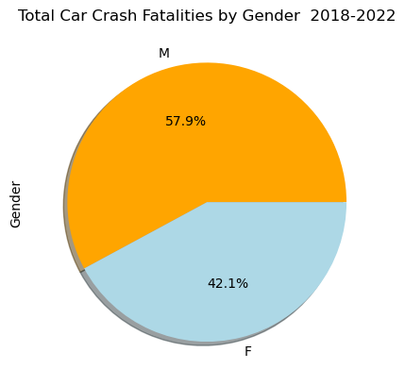
Our first results were represented in a simple pie plot to visually convey our finding by percentage.
Here’s the plot that we used for this chart:
colors=['orange', 'lightblue']
genderdat['SEX'].value_counts().plot(kind='pie',
colors=colors,
shadow=True,
autopct='%1.1f%%')
plt.title('Total Car Crash Fatalities by Gender 2018-2022')
plt.show()

Slide 16
Next, we took a look at car crash fatalities related to age, using the same limited dataset.
27.0 5459
25.0 5438
28.0 5377
26.0 5317
24.0 5281
29.0 5168
23.0 5103
30.0 4790
31.0 4489
22.0 4485
33.0 4306
32.0 4272
36.0 4068
35.0 4056
34.0 3987
21.0 3945
37.0 3840
38.0 3773
39.0 3601
20.0 3580
40.0 3387
41.0 3358
42.0 3240
47.0 3193
45.0 3147
48.0 3142
19.0 3102
43.0 3092
44.0 3073
46.0 3065
49.0 2898
51.0 2867
52.0 2855
50.0 2854
18.0 2779
54.0 2744
53.0 2714
55.0 2593
56.0 2491
57.0 2457
58.0 2396
0.0 2332
59.0 2252
60.0 2194
61.0 2050
62.0 1931
17.0 1926
63.0 1882
64.0 1580
65.0 1511
Name: AGE, dtype: int64
First, we used a simple value_counts function to generate and sort a listing of fatalities by age.
people_data['AGE'].value_counts().nlargest(50)

Slide 17
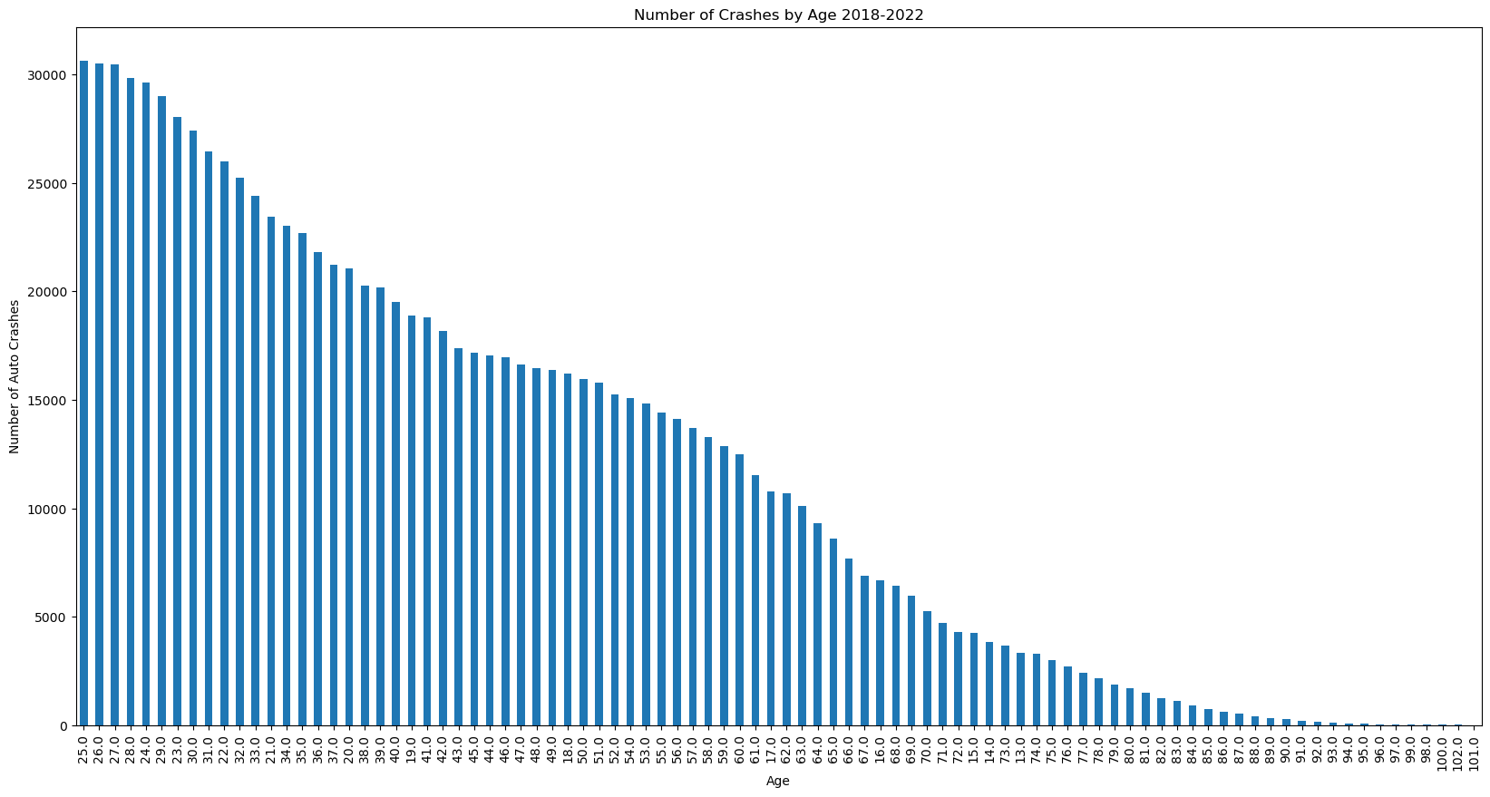
We then used a bar chart to represent the same results visually.

Slide 18
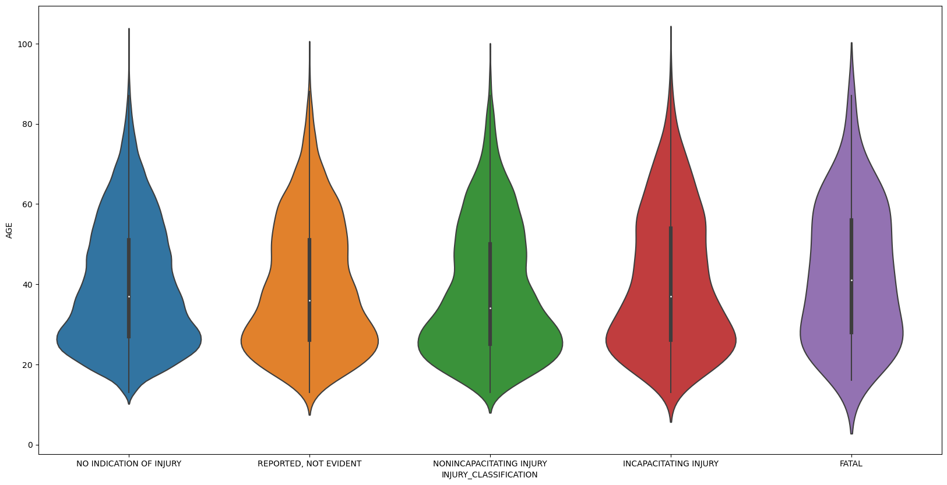
We further broke out the injury data by type of injury by age, using Seaborn to produce the following Violin plot.

Slide 19
Auto Fatalities by Road Attribute -
Number of Lanes and Posted Speed Limit
This section uses automobile collision data from the City of Chicago Data Portal to examine the relationships between roadway type and the rate of injuries and fatalities in automobile accidents over the past 5 years

Slide 20
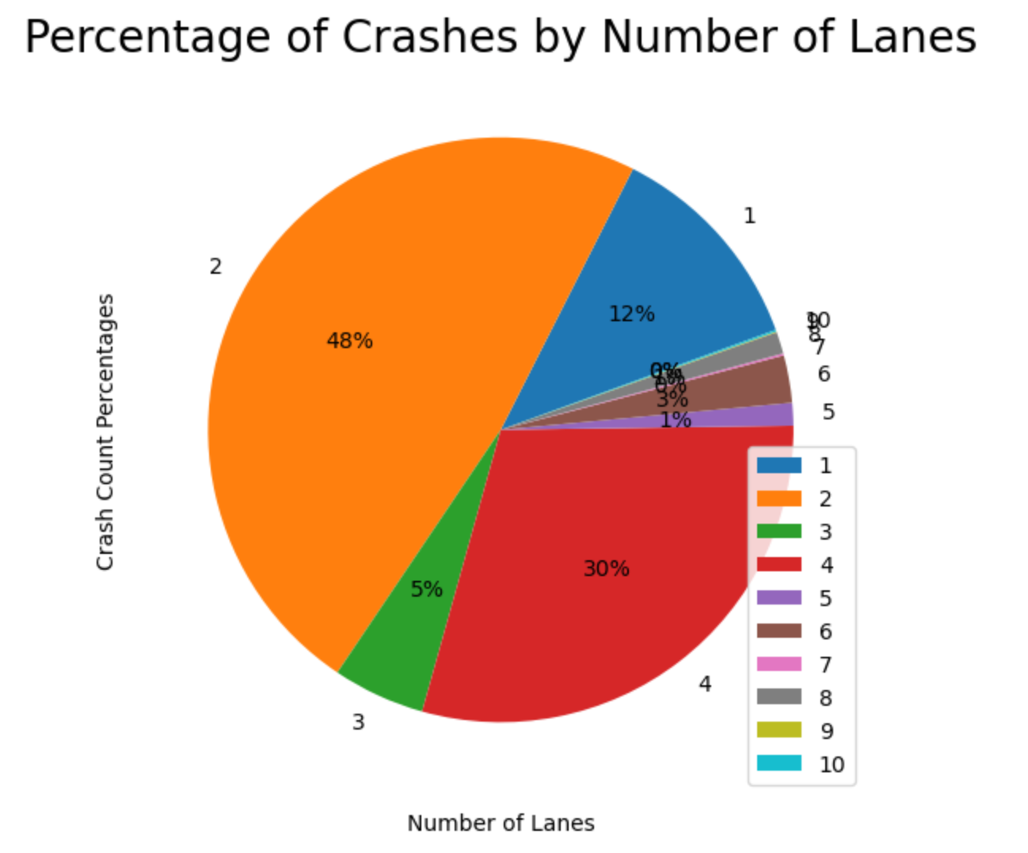
First, we found that the vast majority of crashes occurred on streets with 2 or 4 lanes.
Notes:
88% of crashes occurred on streets with 2 or 4 lanes - which seems to correspond to the street layout we see in Chicago.

Slide 21
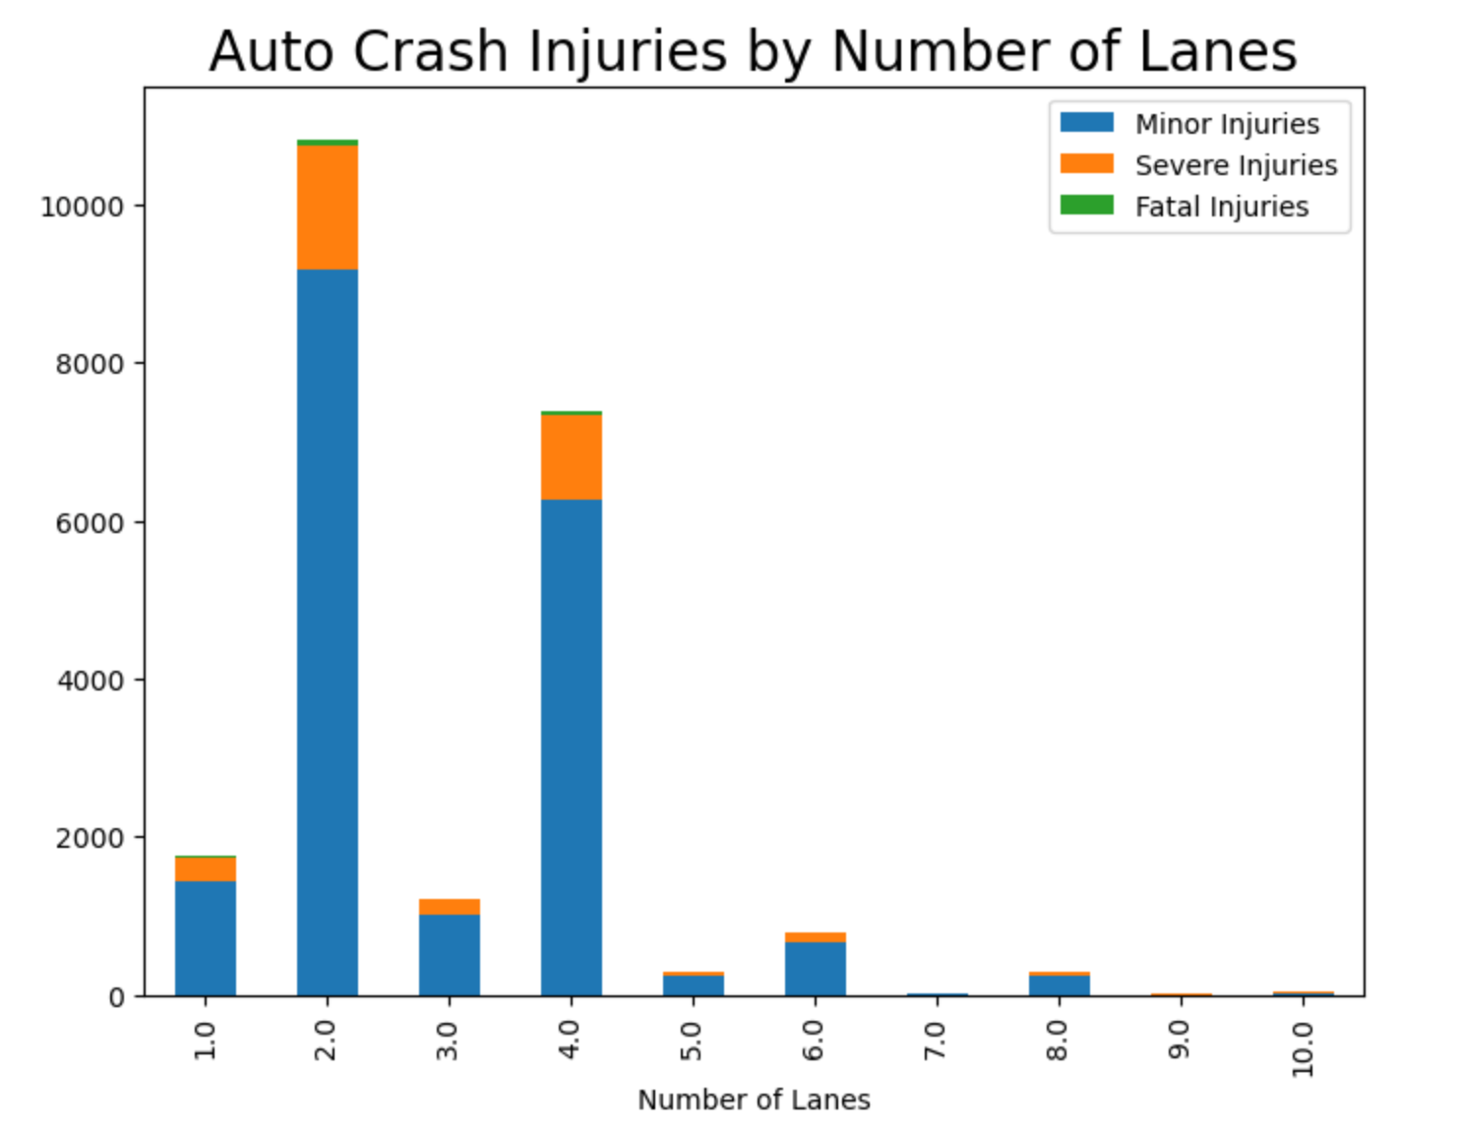
Next, we found the number of car crash injuries by number of lanes

Slide 22
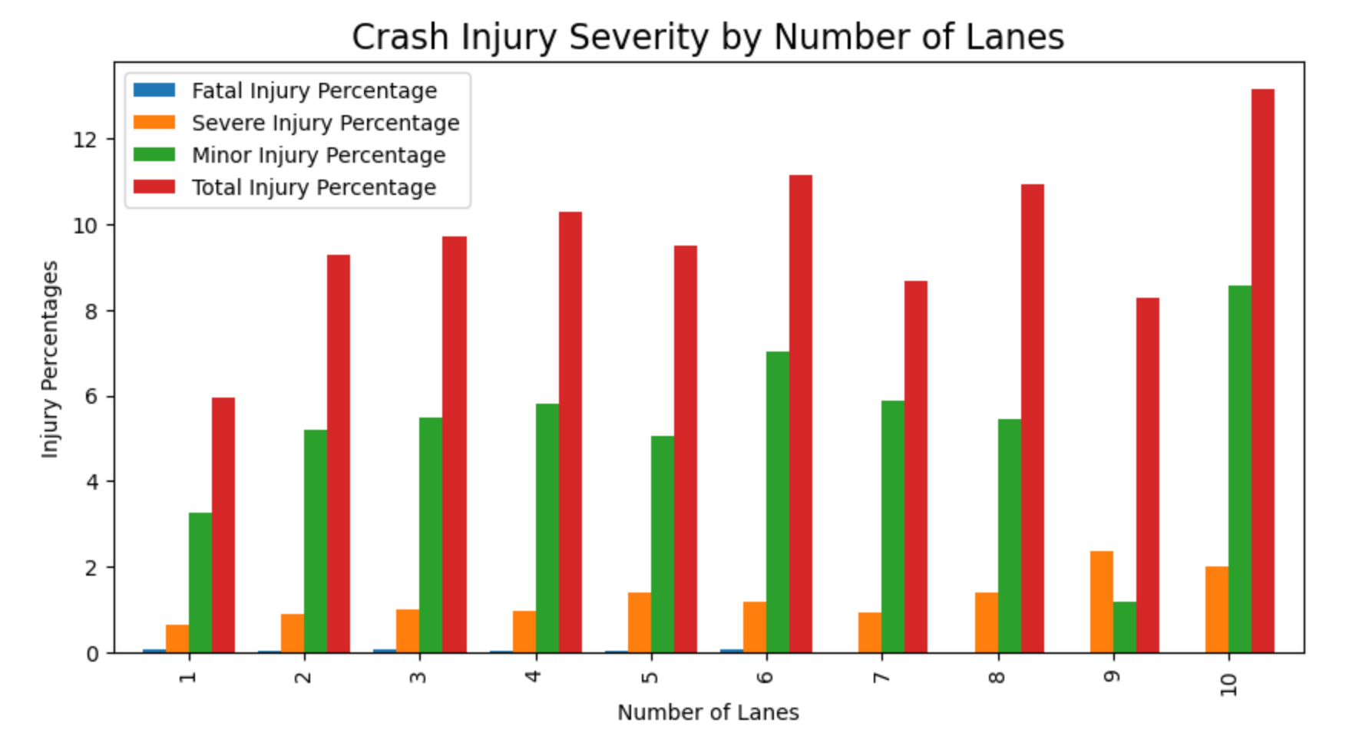
Then we took a look at what percentage of car crashes resulted in injuries by number of lanes

Slide 23
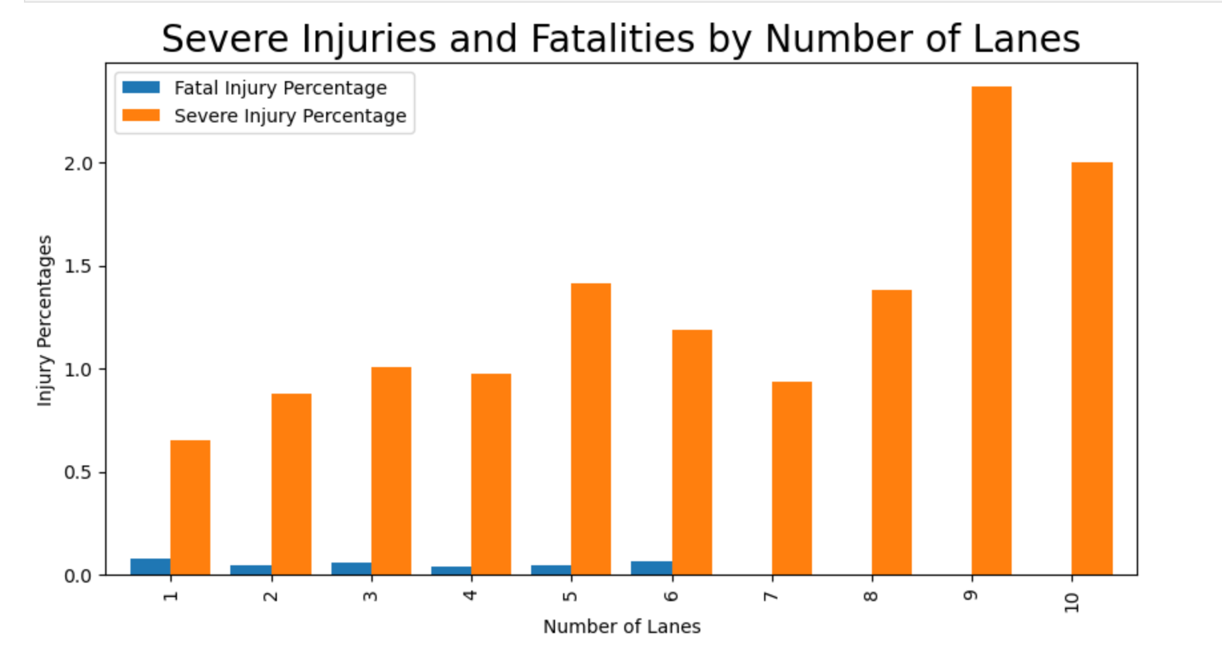
Zooming in on the severe injuries and fatalities …

Slide 24
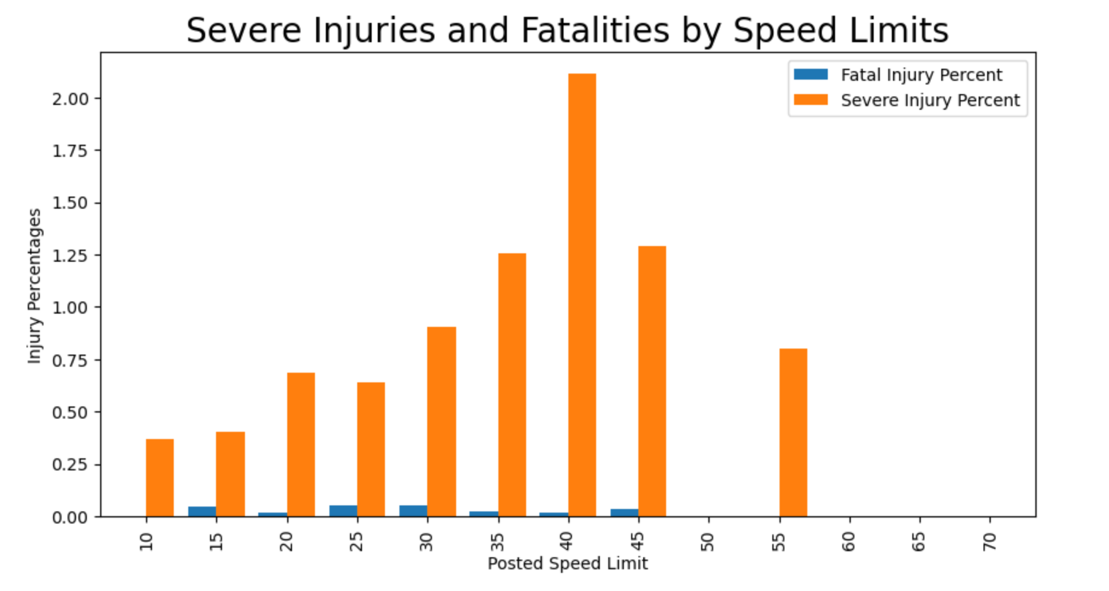
Next, we took a look at Severe Injuries and Fatalities by Posted Speed Limit

Slide 25
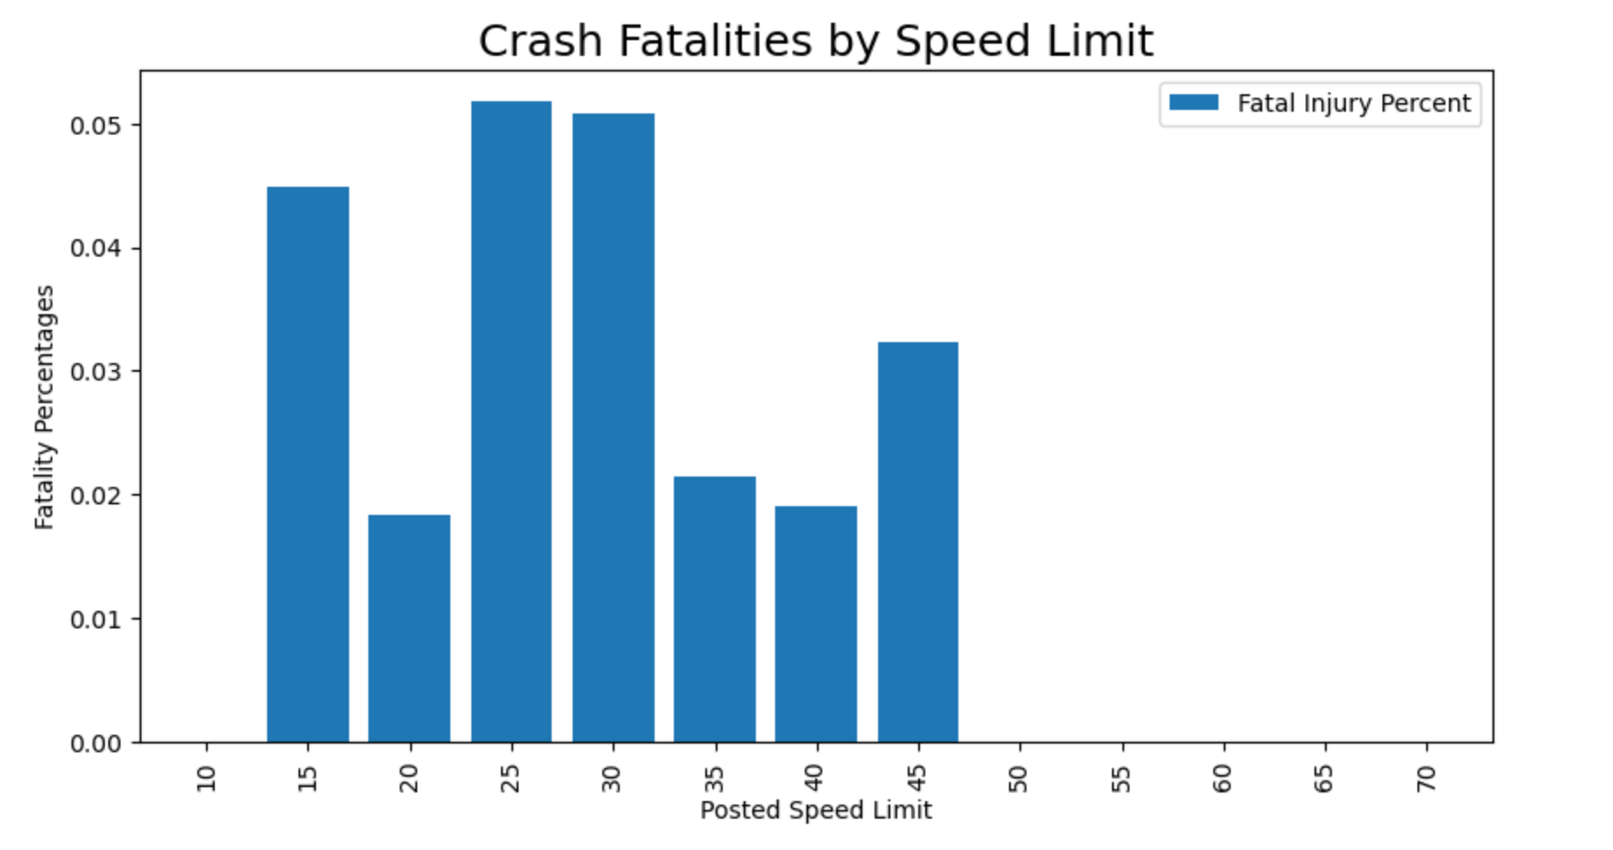
Zooming in on just the fatalities …

Slide 26
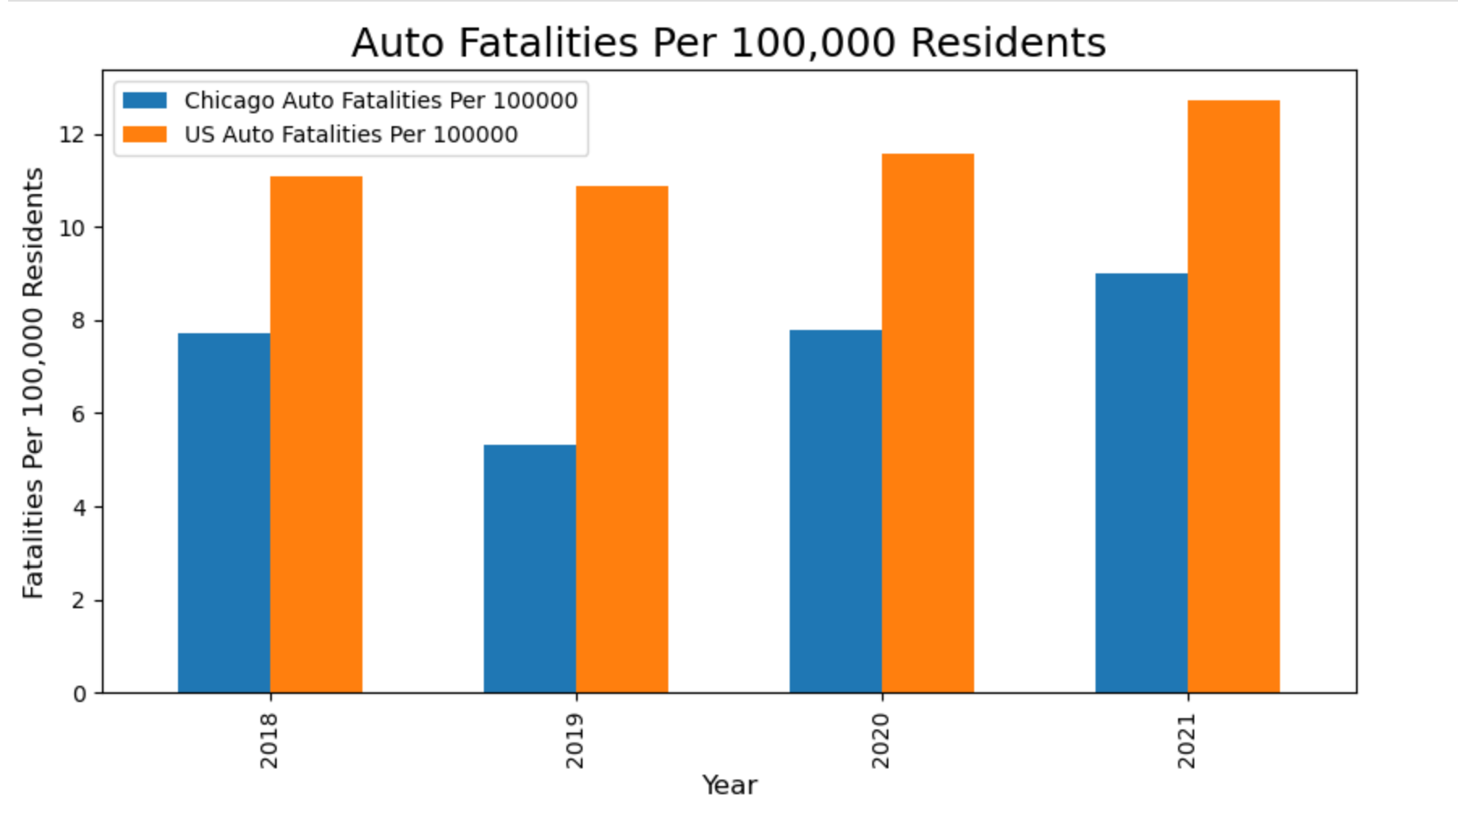
Chicago Auto Fatalities vs. the National Average
Notes:
Chicago 29% safer than the national average

Slide 27
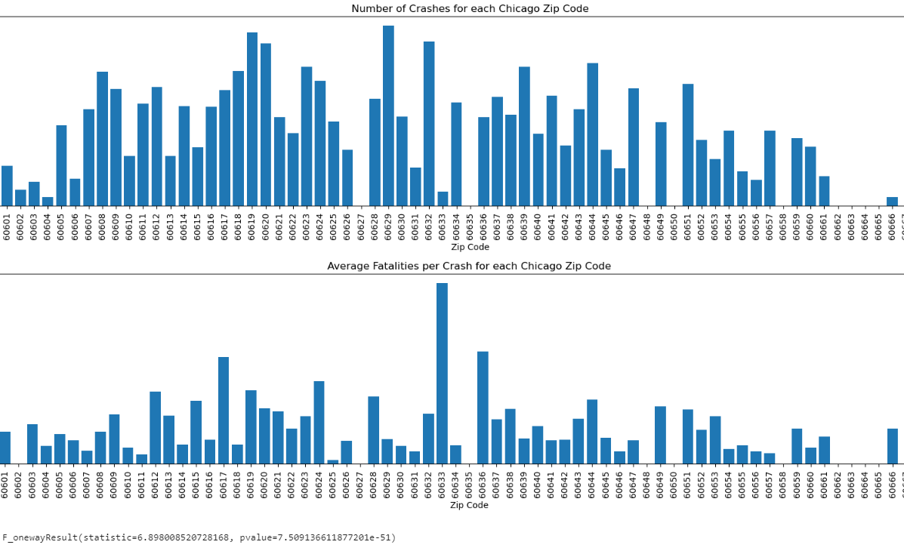
Zip Code Analysis
Highest numbers of crashes and injury/fatality rates concentrated around I-57/I-94 Interchange and Midway Airport (60629, 60619, 60632, 60633)
Geographic data gathered from <https://www.arcgis.com/home/item.html?id=8d2012a2016e484dafaac0451f9aea24>

Slide 28
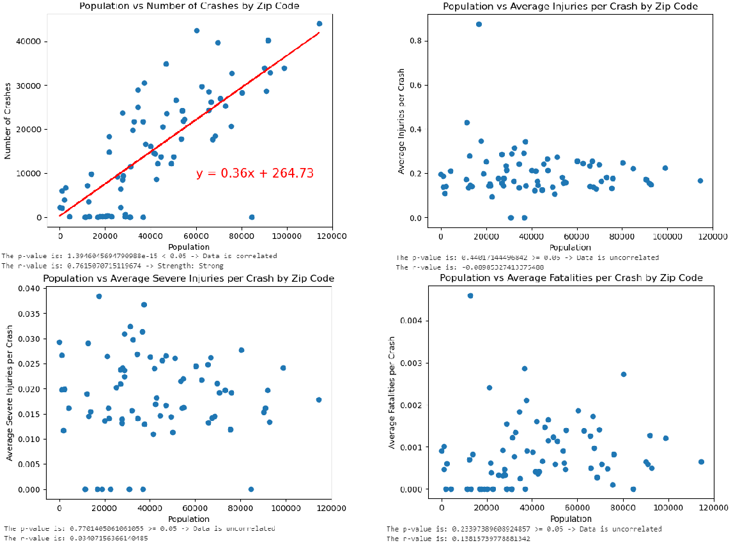
Strong correlation found between Population and Number of Crashes (r=0.76 p≈0.00)

Slide 29
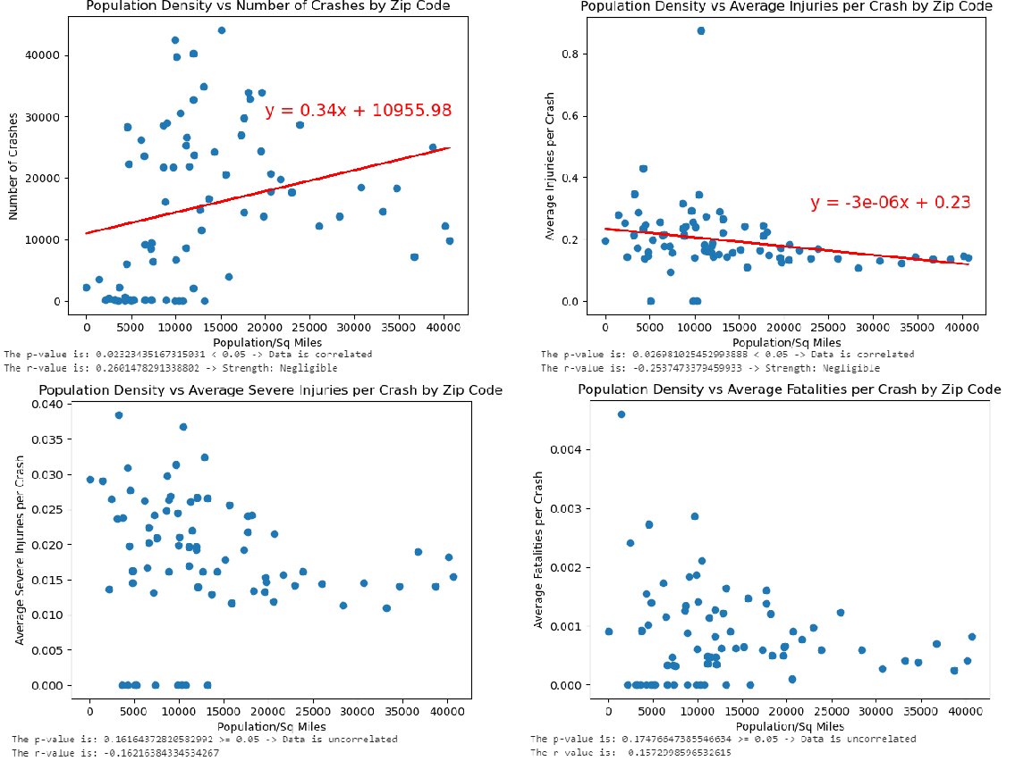
Negligible correlations found between Population Density and Number of Crashes (r=0.26 p=0.02) and Population Density and Injury Rate (r=-0.25 p=0.02)

Slide 30
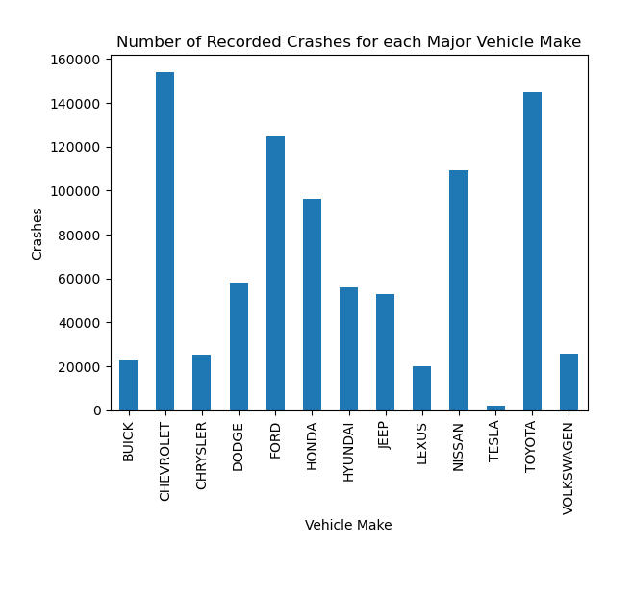
Major Vehicle Makes
We began by filtering our data down to the major vehicle manufacturers for aggregation against number of crashes and average injuries/fatalities

Slide 31
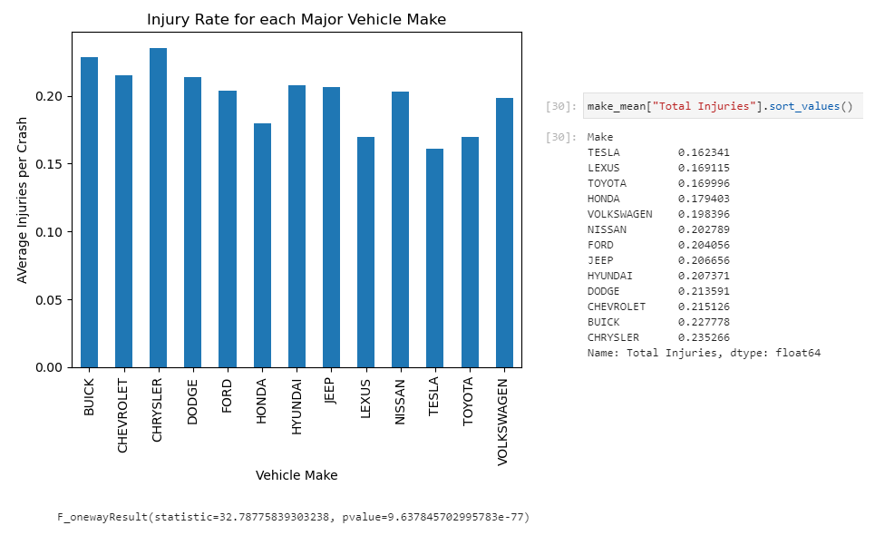
ANOVA testing yielded significant difference between mean injury rates (p≈0.00)

Slide 32
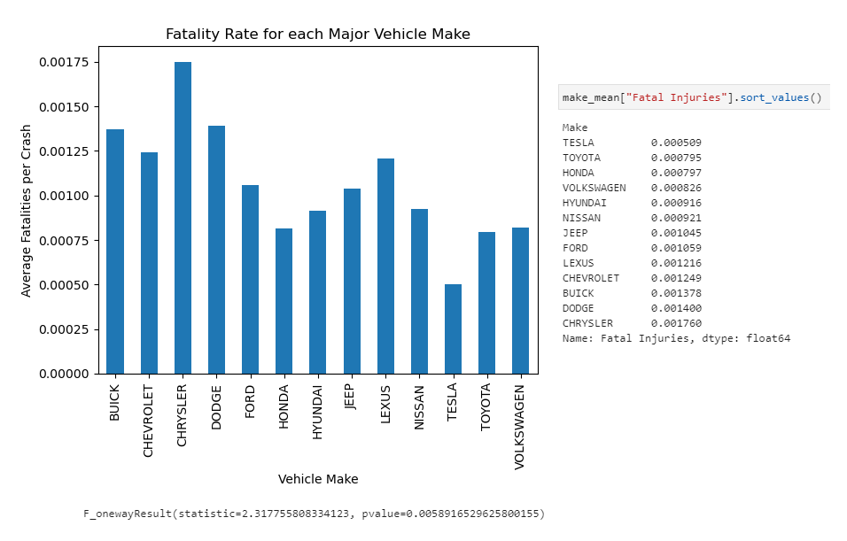
ANOVA testing yielded significant difference between mean fatality rates (p=0.005)
Also note that the top 4 makes for both highest injury and fatality rate are Chevy, Buick, Dodge, Chrysler - with Chrysler at number 1 in both categories

Slide 33
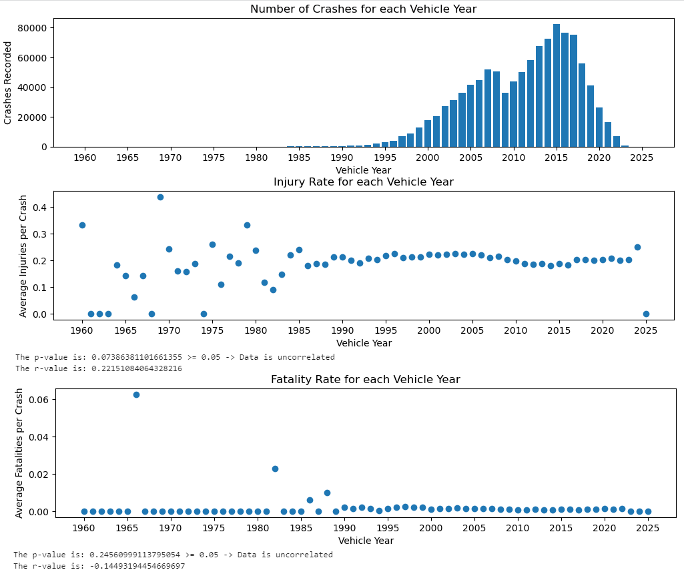
Vehicle Year
No significant correlation found between year of manufacture and injury/fatality rate. ANOVA testing or broader data collection could yield further insights.
Notable drop in recorded crashes for vehicles from 2009-2010 - perhaps due to the economic recession?

Slide 34
Questions & Comments

